Slide 1

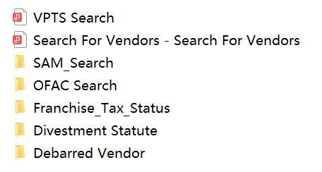


Vendor Check Automation
Xuan Wang
School of Information, The University of Texas at Austin
Organization: Texas Department of Information Resources
Field Supervisor: Sharon Blue
Abstract
Output format
Conclusions and Future Work
This capstone project is an automated process to complete 7 vendor checks and store the results as openable PDF documents for the DIR contract managers. It is a python-based program that involves web scraping, database query, and auto-creation of documents. Vendor account information is fetched from Salesforce by using the Salesforce REST API client.
This program is primarily for contract managers to perform pipelined checks on a specific vendor. The contract manager only needs to provide the vendor's name or id, and the program will automatically execute all the checks in sequence. These checks include:
Franchise Tax Status check;
HUB Status check;
Vendor Performance check;
US Government System for Award Management check;
US Government Office of Foreign Assets Control check;
Texas Comptroller of Public Accounts Debarred Vendor List Search;
Texas Comptroller of Public Accounts Divestment Statue Lists Search
To make this program more user-friendly to non-technical personnel, I applied the headless web scraping method to avoid opening new browsers for each webpage.
For future work, it would be more convenient for the DIR contract managers to use this program directly inside the Salesforce platform.
Methodology
I used different python methods to query and download files for different page source structures. There are three main ways:
requests
Use this method to retrieve data from a specific source (website)
Selenium
Implemented website interface testing with the support of Chrome WebDriver
Salesforce (Database)
Provided Salesforce credentials with API access
Queried Salesforce Data Using SOQL

